Slide 1
Project 2 ai bootcamp SMU STROKE PREDICTION
Anderson, Gabriel
Lavieri, Juan Carlos
Lerma, Fidel

Slide 2
AGENDA
Introduction
Primary goal
The Data
Common Process
Individual Paths
Summary

Slide 3
Health Data Analytics Institute
Chief Medical Officer

Slide 4
INTRODUCTION
According to the World Health Organization (WHO) stroke is the 2nd leading cause of death globally, responsible for approximately 11% of total deaths.
This dataset is used to predict whether a patient is likely to get stroke based on the input parameters like gender, age, various diseases, and smoking status. Each row in the data provides relevant information about the patient.

Slide 5
PRIMARY GOAL
To predict as accurate as possible the risk of stroke occurrence in patients based on their health history. Using ML with the use of models (algorithm), to better identify each case, based on the data set downloaded from Kaggle, allegedly obtain from the WHO (World Health Organization).
To contribute & help medical professionals to prevent cases of “Stroke”, while finding the parameters used for study in their own patients.
The primary aim of our presentation is to encourage the adoption of our Stroke Prediction model within the institute’s health data analysis framework. Currently, the institute relies on traditional statistical methods for predicting stroke risks, which, while effective, do not fully leverage the predictive power of advanced machine learning techniques. By integrating our model, the institute can significantly improve the accuracy and speed of stroke risk prediction. This enhancement will enable more timely and personalized medical interventions, potentially saving lives and reducing long-term healthcare costs.

Slide 6
The data source: healthcare-dataset-stroke-data.csv (5110 records)
​id | gender | age | Hyper-tension | heart disease | ever married | Work type | Residence type | Average Glucose level | Bmi | Smoking status | Stroke
9046 | Male | 67 | 0 | 1 | Yes | Private | Urban | 228.69 | 36.6 | Formerly smoked | 1
51676 | Female | 61 | 0 | 0 | Yes | Self-Employed | Rural | 202.21 | NaN | Never smoked | 1
31112 | Male | 80 | 0 | 1 | Yes | Private | Rural | 105.92 | 32.5 | Never smoked | 1
60182 | Female | 49 | 0 | 0 | Yes | Private | Urban | 171.23 | 34.4 | smokes | 1

Slide 7
“features” of the data Different VALUES / value ranges
​id | gender | Age (yrs) | Hyper-tension | heart disease | ever married | Work type | Residence type | Average Glucose level | bmi | Smoking status | Stroke
Not used | Male | 0.08 | 0 (no) | 0 (no) | Yes | Children, | Urban | 55.12 | NaN, | never Smoked | 0 (no)
as part of | Female | to | 1 (yes) | 1 (yes) | No | Never worked, | Rural | to | 10.3 | unknown | 1 (yes)
The model | Other | 82 |  |  |  | Self-Employed, |  | 271.74 | to | Formerly smoked
 |  |  |  |  |  | Govt_job, Private |  |  | 97.6 | smokes

Slide 8
an ounce of prevention is worth a pound of cure.​
Benjamin Franklin

Slide 9
prediction models & project PLAN
Present the results of the process, recommendations and Explain Limitations
CLEANING
Clean the data: drop columns and rows that might complicate or obstruct the model training
SCALING
Scale the Data to obtain more objective results
Train with different models and test against available data to find the best results
Review and compare results between models
PRESENTATION
TRAIN/SPLIT/
TEST
ANALYSIS

Slide 10
Machine Learning model's score
Scores used to evaluate the accuracy of the models

Slide 11
Model metrics summary
Precision: Precision measures the ratio of correctly predicted positive observations to the total predicted positives. It's the accuracy of positive predictions. Mathematically, it's defined as Precision = True Positives / (True Positives + False Positives). This metric is important when the cost of False Positives is high.
Accuracy: Accuracy is the most intuitive performance measure, and it is simply a ratio of correctly predicted observations to the total observations. It's the number of correct predictions made divided by the total number of predictions. Mathematically, Accuracy = (True Positives + True Negatives) / Total Observations. It's useful when the class distributions are similar.
F-1 Score: The F-1 Score is the weighted average of Precision and Recall. Therefore, this score takes both false positives and false negatives into account. It's a good way to express the model's performance when you have uneven class distribution. Mathematically, F1 Score = 2*(Recall * Precision) / (Recall + Precision).
Recall Score: Recall (also known as Sensitivity or the True Positive Rate) measures the ratio of correctly predicted positive observations to all observations in the actual class. It answers the question "Of all the actual positives, how many did we label?" Mathematically, Recall = True Positives / (True Positives + False Negatives). This metric is important when the cost of False Negatives is high.
PRECISION
ACCURACY
F-1 SCORE
(harmonic mean of P & R)
RECALL SCORE
Precision = True Positives / (True Positives + False Positives)
Accuracy = (True Positives + True Negatives) / Total Observations
F1 Score = 2*(Recall * Precision) / (Recall + Precision)
Recall = True Positives / (True Positives + False Negatives)False Negatives)
Number of Positive Values Correctly Calculated/ Predicted by the Training Model as Positive (1/Yes)
Number of Values Correctly Calculated/Predicted by the Training Model as Negative
(0/No )
Number of Negative Values Incorrectly Calculated/ Predicted by the Training Model as Positive (0/No )
Number of Positive Values Incorrectly Calculated/ Predicted by the Training Model as Negative
(1/Yes )
TP
TN
FP
FN
TRUE POSITIVE
TRUE NEGATIVE
FALSE POSITIVE
FALSE NEGATIVE

Slide 12
The first model
By working with "Manually" balanced and proportionally imbalanced training samples the resulting score went from 0% to reliable 26.07%

Slide 13
observations
1
Data is EXTREMELY imbalanced with 95.12% of the cases negative for a stroke
2
3.93% of the Data is missing values for BMI, this records were excluded
Three of the features (gender, ever married, residence type) have only *two possible values than can be encoded to 0 (no) / 1 (yes) values
*gender shows 1 record with the value "Other", this record was excluded
3
4
Two of the features (work type, smoking status) need to be converted to multiple features or assigned a numerical value to the possible string values (encoded)

Slide 14
FIRST MODEL REASONING
95% negative results (no-stroke) leads to training for no-stroke conditions. The data needs to be proportionally balanced/imbalanced to find the best training ratio conditions.
Data Imbalance
Proportional "Balancing"
Data Sets with positive results and randomly selected negative results from the original set are used to create test samples ranging in ratio from 1:1 (Balanced) to 1:7 (very imbalanced).
Two versions of the data were created for modeling where the "work type" and "smoking status" features where : 1: split into features with 0/1 values representing each possible value, 2: assigned a "weight" value to encode the values in the feature.
Encoding and splitting
Training and Results Gathering
3 Machine Learning models were trained with 7 potentially different data sets 160 times to generate 3360 records with various result metrics.

Slide 15
First model findings (F1-Scores)
HIGHEST SCORES
Positive : Negative
AVERAGE SCORES
Positive : Negative
MODEL LIMITATIONS
Ratios 1:4, 1:5 and 1:6 had max f1-scores between 39.66% and 40.22%
With only 1 result record each
Ratios 1:2 and 1:3 had the highest average f1-scores of 26.07% and 25.32% respectively
649 records (19.31% of results) are included in this range
Based on the tests, this model should be able to accurately predict a possible stroke in approximately 1 out of 12 cases

Slide 16
HOW DID WE GET FROM 0 TO 63.84%
No PII’s, balance data
(Stroke_Predictions_3)
Feature Engineering to the entire Data Frame
(Stroke_Predictions_6)
Enhancing feature engineering by creating interaction terms and polynomial features
(Stroke_Predictions_7)
gender | age | hypertension | heart disease | avg_glucose_level | bmi | smoking status | stroke
Original Data
Data Clean (no ID’s)
Unbalance data 95.12 to 4.87
Balance data 50 to 50 (SMOTE)
Feature Engineering
RFC- RandomForestClassifier (2% recall)
Receiver Operating Characteristics (ROC) Curve
Confusion Matrix (TP 1460 cases)
​​​
Original Data
cleaned_healthcare_stroke_data.csv
Unbalance data 95.12 to 4.87
Balance data 50 to 50 (RandomOverSampler, 3760 cases of each)
LogisticRegression, RandomForestClassifier, SVC, KNeighborsClassifierGradientBoostingClassifier, XGBClassifier,Decision Tree, Receiver Operating Characteristics (ROC) Curve
Feature Engineering & Polynomial Features
Pipeline, SMOTE, SelectFromModel, GridSearchCV, StratifiedKFold, make_scorer, recall_score (Recall Score 63.84%)
​​​
Original Data
Data Clean with NO PII’s
Unbalance data 95.12 to 4.87
Balance data 50 to 50 (SMOTE)
RFC- RandomForestClassifier (2% recall)
Confusion Matrix (0% recall)

Slide 17
SUMMARY
When started working on the date set, thought that the best way to approach it, was using unbiased data. Removed all the PII’s, and the results were disappointing for saying the least.
Then, allowed the data to lead me, and went back to the original data, removing ID’s. Continue working with RandomForestClassifier, as the recommendation was to use it to obtain better accuracy. Once again, results were better, but, with room for improvement. When used Confusion Matrix to visualize, got excited as the (TP) true positive cases went from 0 on the first attempts, to 1460 cases of “stroke”
Those results kept me thinking on the room for improvement on predictions, then, instead of continue working with the original data, created a new one named: 'cleaned_healthcare_stroke_data.csv’. Which after removing ID’s, jumped into using a variety of models at once (7) to be exact, looking for better results. The accuracy scores represent the proportion of correctly predicted instances out of the total instances in the dataset. High accuracy is generally desirable, but it's important to consider other metrics like precision, recall, and F1-score, especially in datasets with imbalanced classes like stroke prediction. Which kept me going and try Confusion Matrix in all of them; still the results on (TP) were too low still, and no recall values. Went back to the board and started working with polynomial features to create a new data frame, after preparing the data apply RFC, and numbers still not even as the obtained on SP6. So, jumped into enhancing feature engineering by creating interaction terms and polynomial features. Still nothing, then, the light came to me, and using: Pipeline, SMOTE, SelectFromModel, GridSearchCV, StratifiedKFold, make_scorer, recall_score, the recall score of 63.84% finally were obtained.

Slide 18
Predictions/conclusions
Stroke_Predictions_3
Stroke_Predictions_6
Stroke_Predictions_7
This accounts for label imbalance. The weighted averages are higher (around 0.89-0.91) due to the high number of 'No Stroke' instances. Interpretation The high-performance metrics for the 'No Stroke' class and the zero metrics for the 'Stroke' class indicate that the model is biased towards predicting 'No Stroke’. Despite the dataset being balanced, the model struggles with predicting the minority class ('Stroke'). This could be due to several reasons, such as the model not being complex enough to capture the nuances of the minority class, or the features not being informative enough for distinguishing between the two classes. The imbalance in the performance metrics suggests the need for further model tuning, feature engineering, or even trying different algorithms that might be more sensitive to the minority class.
The matrix is divided into four parts : True Negatives (TN): 1449 cases were correctly predicted as "No Stroke. "False Positives (FP): 8 cases were incorrectly predicted as "Stroke“ False Negatives (FN): 0 cases of "Stroke" were missed by the model. True Positives (TP): 1460 cases were correctly predicted as "Stroke“ This confusion matrix indicates a highly accurate model with a very high true positive rate and a low false positive rate.
Best recall found: 0.6348484848484849:
The recall score is approximately 0.6348, which is a significant improvement from the previously reported score. This means the best model from this search correctly identifies about 63.48% of all actual positive cases.
A higher recall score is particularly important in medical contexts like stroke prediction because it means that the model is better at catching true stroke events, which is critical to avoid missing cases that require immediate medical attention.
The reported "best parameters" suggest a pipeline that effectively combines feature selection, SMOTE for oversampling, and a Random Forest classifier to achieve a recall score that is much more acceptable for predictive tasks where the cost of false negatives is high.

Slide 19
Graphs used for visualizations
Whole team visualizations
“Legend:
Slides 20 - 26 JCL
Slides 28-30 GA

Slide 20
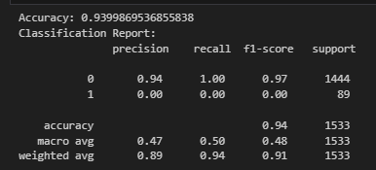
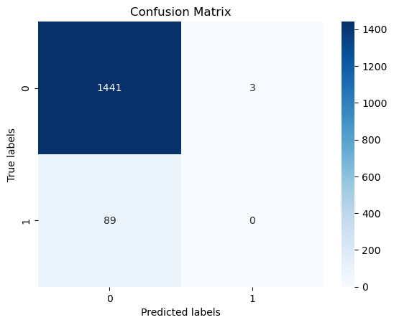
Stroke_Predictions_3

Slide 21
Interpreting data analysis & graph on slide 20
Data analysis Overall Accuracy (Accuracy: 0.9399)
- This indicates that about 94% of your predictions were correct. Accuracy is a useful measure when the classes are balanced, but in the case of imbalanced classes (like in your dataset), it might not be the best indicator of performance. Classification Report The classification report provides a detailed analysis of the model's performance for each class:
Class '0' (No Stroke)
Precision: 0.94 - This means that 94% of the instances predicted as 'No Stroke' were actually 'No Stroke'. High precision relates to a low false positive rate. Recall: 1.00 - This indicates that the model correctly identified 100% of the 'No Stroke' cases. High recall relates to a low false negative rate.F1-Score: 0.97 - The F1-score is the harmonic mean of precision and recall. A score of 0.97 is quite high, indicating good performance for this class.
Class '1' (Stroke)
Precision: 0.00 - This suggests that none of the instances predicted as 'Stroke' were actually 'Stroke' (or there were no predictions made for this class).Recall: 0.00 - This means that the model failed to correctly identify any 'Stroke' cases.F1-Score: 0.00 - A low F1-score for this class indicates poor performance. Macro and Weighted Averages Macro Average: It calculates metrics for each label and finds their unweighted mean. This does not take label imbalance into account. The macro average precision, recall, and F1-score are all around 0.47-0.48, indicating poor overall performance across both classes. Weighted Average: It calculates metrics for each label, and finds their average, weighted by the number of true instances for each label. This accounts for label imbalance. The weighted averages are higher (around 0.89-0.91) due to the high number of 'No Stroke' instances. Interpretation The high-performance metrics for the 'No Stroke' class and the zero metrics for the 'Stroke' class indicate that the model is biased towards predicting 'No Stroke’. Despite the dataset being balanced, the model struggles with predicting the minority class ('Stroke'). This could be due to several reasons, such as the model not being complex enough to capture the nuances of the minority class, or the features not being informative enough for distinguishing between the two classes. The imbalance in the performance metrics suggests the need for further model tuning, feature engineering, or even trying different algorithms that might be more sensitive to the minority class.

Slide 22
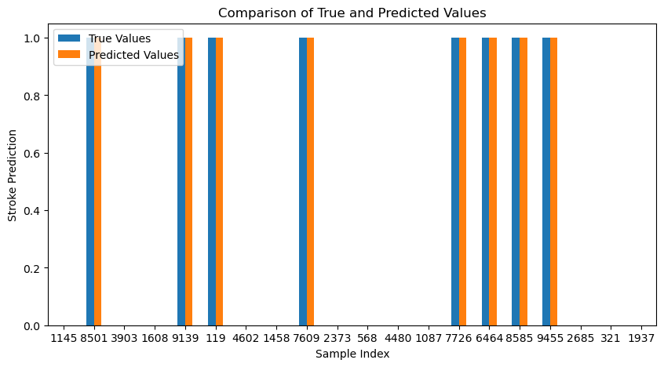
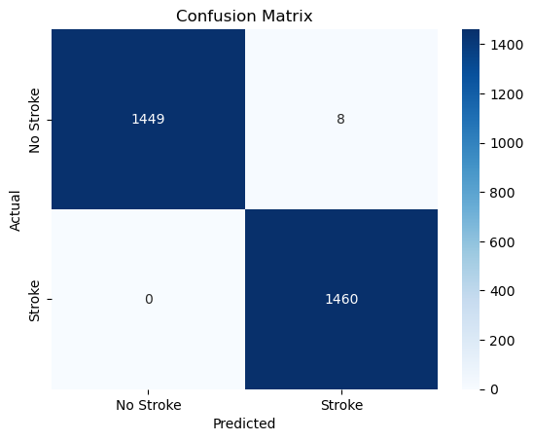
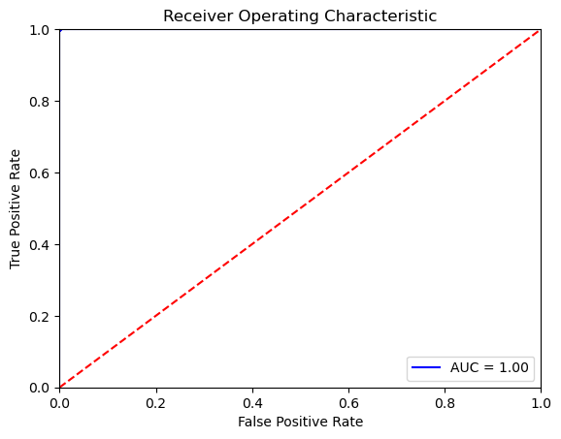
Stroke_Predictions_6

Slide 23
Interpreting graphs on slides 22
Bar Chart of Predictions: The bar chart compares the true values (actual outcomes) with the predicted values (model predictions) for a sample of cases. The bars show that for each given index (representing individual patients or samples), the model's predictions (orange bars) align with the actual values (blue bars). This suggests that the model is predicting with high accuracy. The perfect overlap between true and predicted values in this bar chart is unusual and may warrant further investigation to ensure the evaluation was done correctly and there is no data leakage or other issues. In summary, while these graphs suggest that the model performs exceptionally well, it is rare to see such perfect results in real-world data. Such results should be scrutinized for potential issues like data leakage, incorrect data labeling, overfitting, or an evaluation mistake. It is essential to validate the model on a completely separate test set that was not used in any way during the model training or selection process. If the results are genuinely this good after thorough validation, then the model is performing exceptionally well at predicting strokes.
Confusion Matrix: This confusion matrix shows the number of correct and incorrect predictions made by the model. The matrix is divided into four parts: True Negatives (TN): 1449 cases were correctly predicted as "No Stroke.“ False Positives (FP): 8 cases were incorrectly predicted as "Stroke. "False Negatives (FN): 0 cases of "Stroke" were missed by the model. True Positives (TP): 1460 cases were correctly predicted as "Stroke. "This confusion matrix indicates a highly accurate model with a very high true positive rate and a low false positive rate. However, like the perfect AUC score, this could be indicative of overfitting or an error in the evaluation process.
Receiver Operating Characteristic (ROC) Curve: This graph is a ROC curve, which plots the true positive rate (TPR) against the false positive rate (FPR) at various threshold settings. The Area Under the Curve (AUC) is a measure of how well the model is able to distinguish between classes. An AUC of 1.0 is perfect, meaning the model has a perfect measure of separability and made no mistakes. However, in real-world scenarios, a perfect AUC is highly unusual and might indicate an issue with the data or an overfitting model.

Slide 24
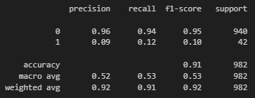
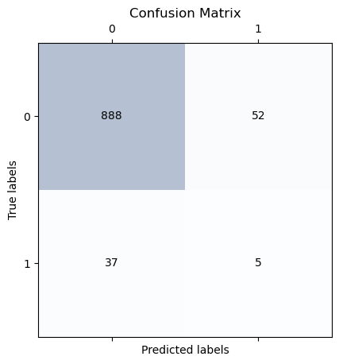
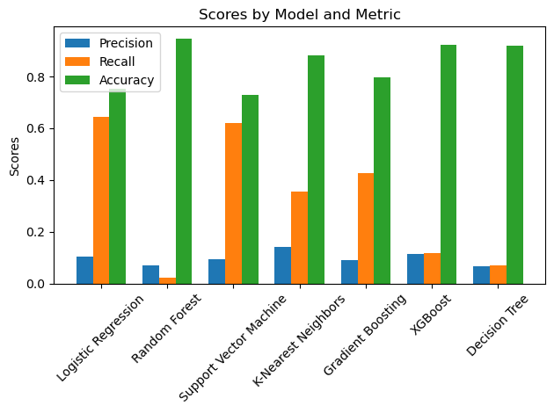
Stroke_predictions_7
Fitting 3 folds for each of 648 candidates, totaling 1944 fits:
Best parameters found: {'classification__max_depth': 10, 'classification__min_samples_leaf': 4, 'classification__min_samples_split': 10, 'classification__n_estimators': 200, 'feature_selection__estimator__n_estimators': 50, 'feature_selection__threshold': 'mean', 'smote__k_neighbors': 5}
Best recall found: 0.6348484848484849

Slide 25
Interpreting Data & graphs on slides 24
Precision: Models like Logistic Regression and Support Vector Machine have higher precision, indicating fewer false positives. However, their recall is lower, meaning they miss more actual stroke cases.
Recall (Sensitivity): The recall scores are generally lower across models, suggesting that identifying actual stroke cases is challenging. Models like Random Forest, XGBoost, and Decision Tree have particularly low recall, meaning they missed a significant number of true stroke cases.
Accuracy: While some models show high accuracy, this metric can be misleading in the context of imbalanced datasets. It's crucial to consider precision and recall, especially in medical diagnostics where missing true positives can be critical.
From this analysis, it's evident that while some models perform well in certain aspects (like precision or accuracy), they might not perform as well in others (like recall). This scenario suggests that there's room for improvement, possibly through feature engineering like creating interactions between columns or further tuning the model parameters.
If you decide to explore feature These metrics provide a more nuanced view of the model performance than accuracy alone, particularly in datasets where classes are imbalanced. The model seems to be conservative in predicting strokes, indicated by the low number of TP and high number of FN, which is critical in medical diagnosis as it's often more important to minimize FN (to catch as many true stroke cases as possible).
These metrics provide a more nuanced view of the model performance than accuracy alone, particularly in datasets where classes are imbalanced. The model seems to be conservative in predicting strokes, indicated by the low number of TP and high number of FN, which is critical in medical diagnosis as it's often more important to minimize FN (to catch as many true stroke cases as possible). Given the low TP and high FN, the model is not performing well in terms of identifying actual stroke cases, which may require adjustments in the model, thresholding, or further feature engineering.

Slide 26
Interpreting Data & graphs on slides 24
Fitting 3 folds for each of 648 candidates, totaling 1944 fits:
The grid search tested 648 different combinations of hyperparameters across the pipeline components.
With 3-fold cross-validation, the total number of model fittings is 1944 (648 parameter combinations multiplied by 3 folds).
Best parameters found:
classification__max_depth: The maximum depth of the trees in the classification model is set to 10. This controls how deep the tree can grow and can help prevent overfitting.
classification__min_samples_leaf: The minimum number of samples required to be at a leaf node is 4, which helps to smooth the model and again prevent overfitting.
classification__min_samples_split: The minimum number of samples required to split a node is 10, providing a balance between the depth of the tree and generalization.
classification__n_estimators: The number of trees in the forest is 200, which is the size of the ensemble of decision trees.
feature_selection__estimator__n_estimators: For the feature selection part, an estimator (likely another Random Forest) with 50 trees is used to assess feature importance.
feature_selection__threshold: The threshold for feature selection is set to 'mean', which likely means that features must have an importance measure greater than the mean of all feature importances to be selected.
smote__k_neighbors: The number of nearest neighbors used in SMOTE for oversampling is 5. This determines how synthetic samples are created for the minority class.
Best recall found: 0.6348484848484849:
The recall score is approximately 0.6348, which is a significant improvement from the previously reported score. This means the best model from this search correctly identifies about 63.48% of all actual positive cases.
A higher recall score is particularly important in medical contexts like stroke prediction because it means that the model is better at catching true stroke events, which is critical to avoid missing cases that require immediate medical attention.
The reported "best parameters" suggest a pipeline that effectively combines feature selection, SMOTE for oversampling, and a Random Forest classifier to achieve a recall score that is much more acceptable for predictive tasks where the cost of false negatives is high.

Slide 27
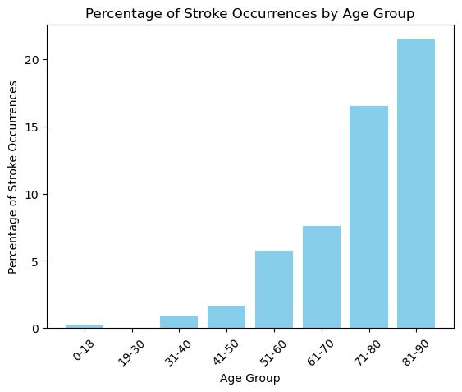
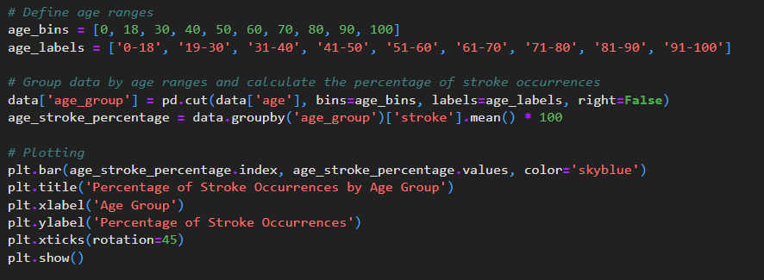
Load and exploring the Data
We loaded the data set which contains some basic information about stroke in patient and our program, we then print some basic information about the data set this helps us understand the structure and contents of our data sets. We then clean the data set which helped us understand the basics. The basics of what I got was that the older you get the more likely of a stroke, but I wanted to go deeper.

Slide 28
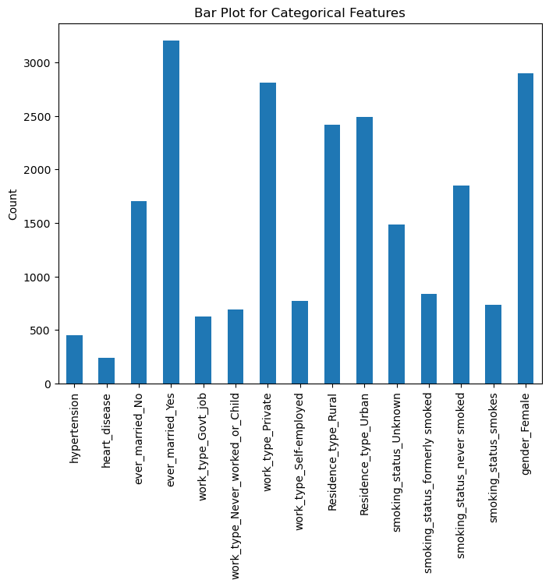
We split our data set into two parts one part for training our machine learning model and the other part for testing its performance. This allows us to understand and evaluate on unseen data. People who smoke and/or are married are more likely to have a stroke even more than people who are simply obese.

Slide 29
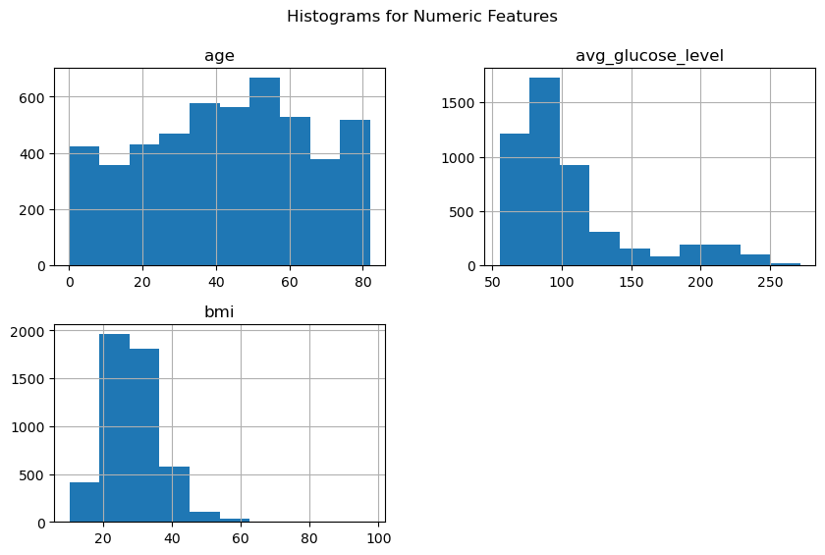
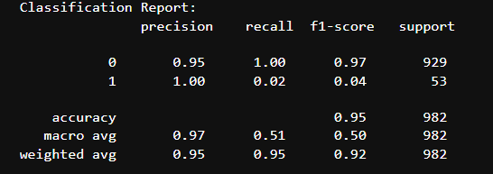
Based on these observations people who are smokers, obese and/or older are more likely to have a stroke according to the data set and this data set is not 100 percent as individual factors may vary based off life choices. With all this was an accuracy of 95 percent based off the data set provided. Model Accuracy: 0.9470468431771895

Slide 30
THANK YOU
Anderson, Gabriel
Lavieri, Juan Carlos
Lerma, Fidel

Slide 31
Questions?
We hope you enjoy our presentation, as much as we did while preparing it.

